Slide 1
Part 1
BEING ON COUNTRY
Notes:
This section could be shortened, covered elsewhere, or explained by a local aboriginal representative.

Slide 2
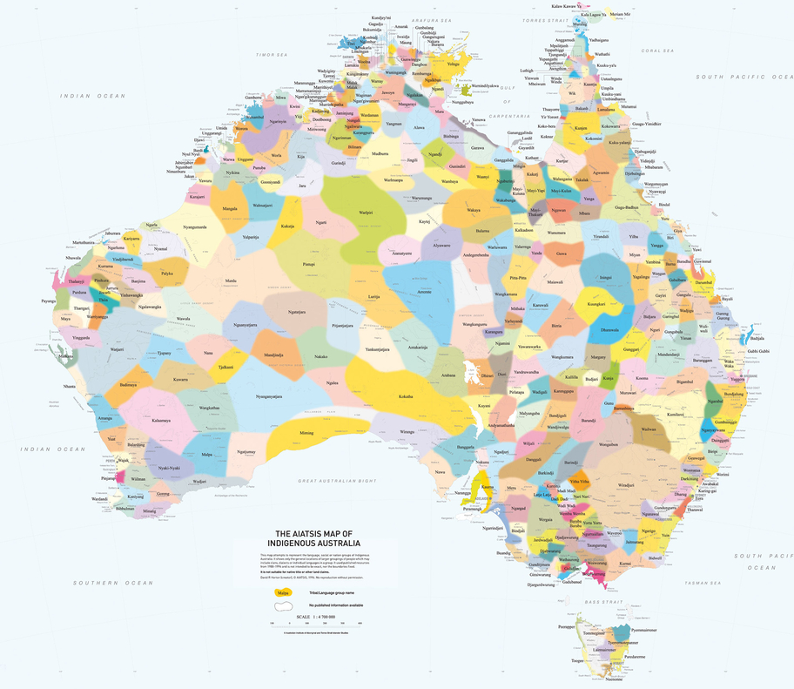
Notes:
Display the AITSIS map and facilitate a class discussion about the AIATSIS Map. Discussion prompts:
Has anybody seen this map before?
What do the different colours and words represent. Aboriginal and Torres Strait Islander Australia is made up of many different groups, each with their own culture, customs, language and laws. This map attempts to represent the nation groups of Indigenous Australia. Each name on the map tells us who the Traditional Custodians of the land are. It tells us whose ‘Country’ we are on. Source: https://aiatsis.gov.au/explore/map-indigenous-australia
What does ‘Country’ mean? Country is the term often used by Aboriginal peoples to describe the lands, waterways and seas to which they are connected. The term contains complex ideas about law, place, custom, language, spiritual belief, cultural practice, material sustenance, family and identity. Source: https://aiatsis.gov.au/explore/welcome-country#toc-what-is-country-
Display the online version of the AIATSIS map on a large screen and show the students how to open it on their laptops. https://aiatsis.gov.au/explore/map-indigenous-Australia. Demonstrate how to zoom in and out and move around the map. Give the students a few minutes to explore the map and familiarise themselves with the zoom function.

Slide 3


Being on Country
What Country is our school located on?
What Country do you live on?
What Country were you born on?
What Country would you most like to visit?
Notes:
Ask the students to write the heading ‘Being on Country’ in their learning journals.
Give the students a few minutes to write their responses the questions on the slide in their learning journal.

Slide 4
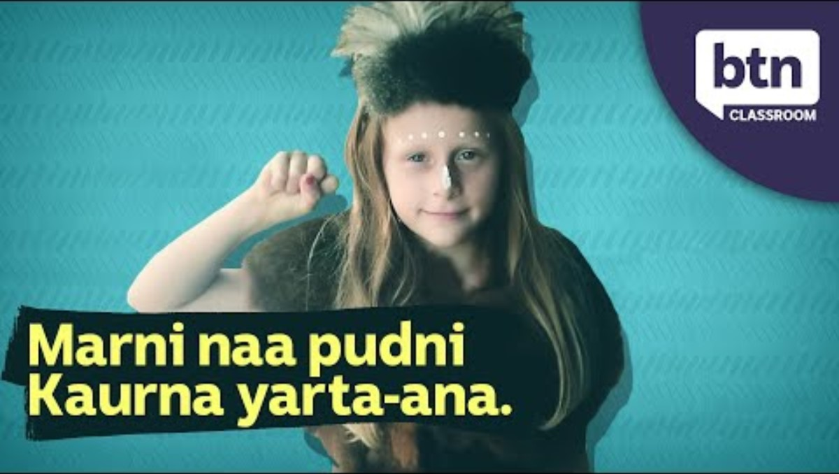
Notes:
Watch the video. Before pressing play tell the students to listen out for the Country that Tiyana is from.
https://www.youtube.com/watch?v=idpod7C-dBs

Slide 5
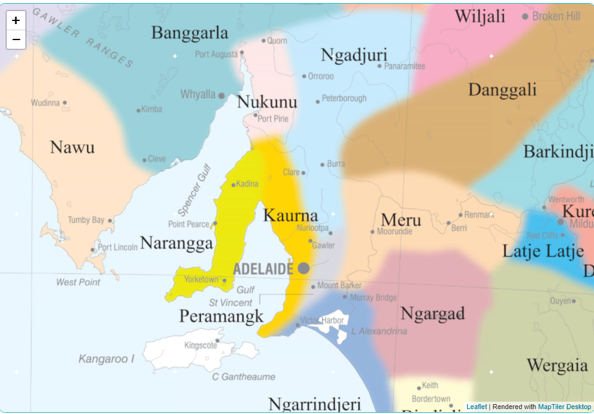
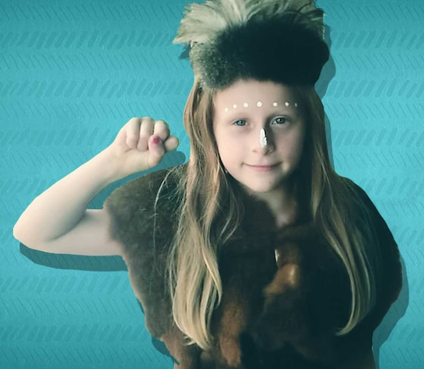
Notes:
Facilitate a discussion about the key concepts in the video. Suggested prompts:
What Country is Tiyana from? Kaurna Country (pronounced ga-na)
What is a Welcome to Country? Welcome to Country has been a part of Indigenous culture for thousands of years. When crossing into another groups Country, you would need to ask permission to enter their land. A Welcome to Country gives you a safe passage and protection during your journey.
Who can give a Welcome to Country? Usually an elder, but sometimes younger people like Tiyana are given permission.
What is an Acknowledgment of Country? It is a way of showing respect for the Traditional Custodians of the land.
Who can give an Acknowledgment of Country? It can be given by both non-Indigenous people and Aboriginal and Torres Strait Islander people.
Ask the students if they have ever seen a Welcome to Country. Encourage them to describe it.
NB: If you are located on Dja Dja Wurrung Country, you may like to watch this video with the students. It features Join Jaara Elder, Uncle Ricky Nelson and Professor Barry Golding who explain the cultural significance of Welcome to Country. https://www.youtube.com/watch?v=ERIkKIORQ98&t=2s
ADDITIONAL TEACHER’S NOTES
A Welcome to Country is delivered by Traditional Owners, or Aboriginal and Torres Strait Islander people who have been given permission from Traditional Owners, to welcome visitors to their Country. It has been a part of Aboriginal and Torres Strait Islander cultures for thousands of years. Before colonization, there were no fences or visible borders, but Aboriginal and Torres Strait Islander groups had clear boundaries separating their Country from that of other groups. Crossing into another group’s Country required a request for permission to enter. When permission was granted the hosting group would welcome the visitors, offering them safe passage and protection during their journey. While visitors were provided with a safe passage, they also had to respect the rules of the land owner group while on their Country. Today, the tradition of welcoming visitors and offering safe passage remain in place. It can take many forms including singing, dancing, smoking ceremonies or a speech in traditional language or English.
An Acknowledgement of Country is an opportunity for anyone to show respect for Traditional Owners and the continuing connection of Aboriginal and Torres Strait Islander peoples to Country.
It can be given by both non-Indigenous people and Aboriginal and Torres Strait Islander people.

Slide 6
Acknowledgment of Country
We acknowledge the _______ people as the Traditional Owners of the land that our school is on and we pay our respects to ________ elders past and present.
Notes:
Ask the students to open a new page in their learning journal and write the heading ‘Acknowledgement of Country’. The students can then write an Acknowledgement of Country using the text on the slide as a guide. If your school already has an Acknowledgment of Country, the students can write that instead.

Slide 7
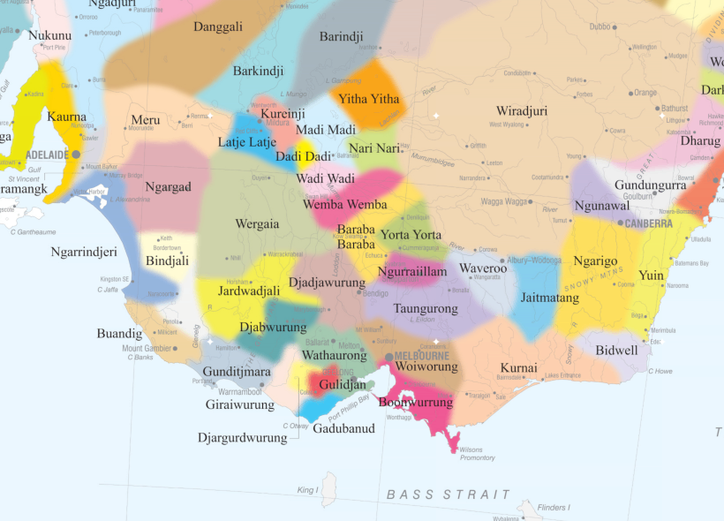
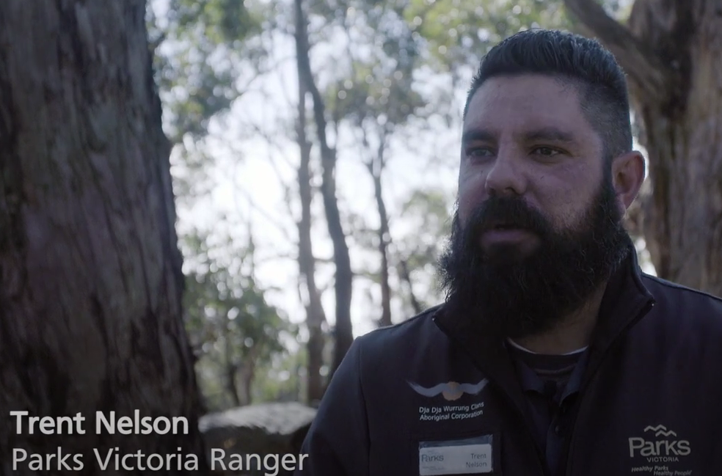
Notes:
Introduce the video ‘Connection to Country: Ranger Trent’. In this video, Dja Dja Wurrung man, Trent Nelson talks about the importance of connecting to and caring for Country.

Slide 8
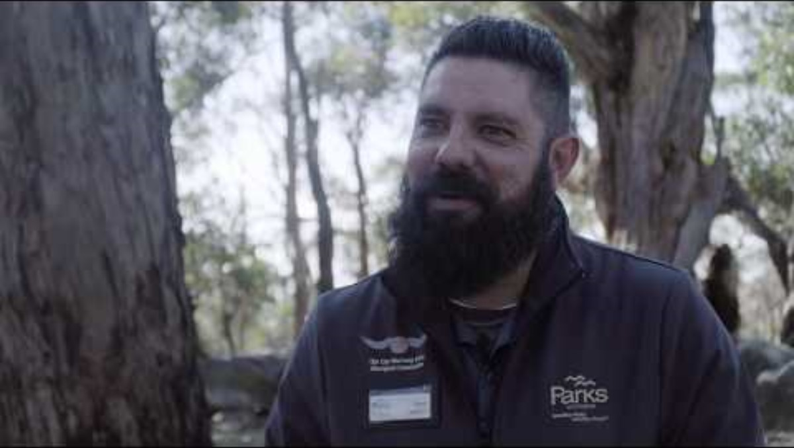
Notes:
Introduce the video ‘Connection to Country: Ranger Trent’. In this video, Dja Dja Wurrung man, Trent Nelson talks about the importance of connecting to and caring for Country.
NB: Video is embedded in the slide. Link to video: https://www.youtube.com/watch?v=DiTW32TEvqQ
Facilitate a discussion about why connecting to and caring for Country is so important to Trent. Suggested prompts:
What is Trent’s connection to Dja Dja Wurrung Country?
How does Trent feel when he is out on Country?
Why is caring for Country so important to Trent?

Slide 9
Caring for Country
One interesting thing I now know is that….
I am still curious about…
One way I could satisfy my curiosity would be to….
Notes:
Ask the students to write the heading Caring for Country in their learning journals and write a short reflection on the video. They can use the sentence stems on the slide as prompts.

